Slide 1
STRENGTH IN NUMBERS
Demonstrating the collective value of ARCHE archives to internal and external stakeholders.
Notes:
Good morning, my name is Amanda. I’m here in my capacity as the co-chair of the ARCHE Archives Council’s Advocacy Committee. I want to share with you the context of the committee, and our research methodology and initial findings.

Slide 2
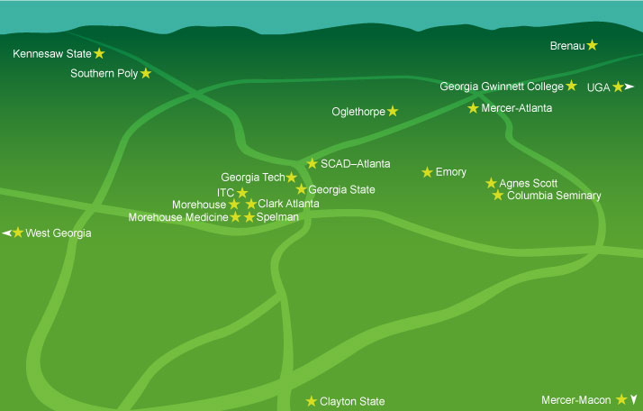
THE PROJECT: REGIONAL STRENGTH = REGIONAL IMPACT
Notes:
This is a project about regional collaboration with the members of Atlanta Regional Council for Higher Education (ARCHE)
The ARCHE Membership is based on geography which encompasses the metro area and includes public and private institutions of higher education
The ARCHE ARCHIVES Council includes the addition of non-higher ed oriented institutions which aren’t represented on this map such as the Carter Library and the Atlanta History Center

Slide 3
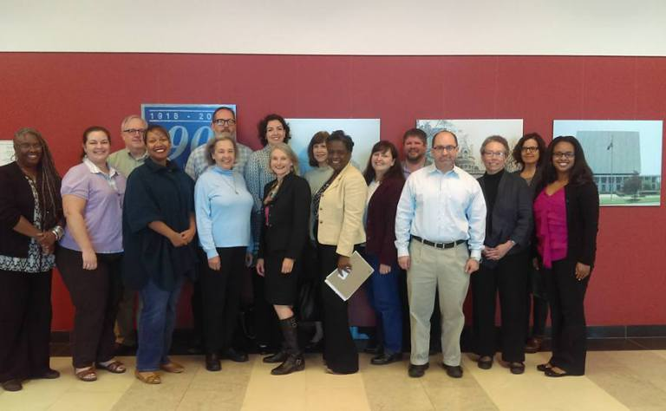
ARCHE Archives Council Advocacy Committee
Vision: Atlanta area leadership will recognize the cultural, social and economic contributions of ARCHE Archives Council members. [external vision]
ARCHE Archives Council members will capitalize on their cultural, social, and economic contributions to the area’s past legacy, present prosperity, and future growth. [internal vision]
Mission: Identify and engage external and internal stakeholders through qualitative and quantitative data to spread the value of ARCHE Council member archives and archivists across a broad audience spectrum.
Notes:
The Advocacy Committee was formed in April of 2017 with the goal of assessing advocacy initiatives for council members and creating partnerships with allied groups and stakeholders. The committee outlined four broad objectives:
To gather useful metrics and data points
To interpret and correlate data with impact statements meaningful to internal and external stakeholders.
To identify and develop opportunities for regular engagement with those stakeholders.
To educate Council members and develop advocacy tools and strategies for their use.

Slide 4
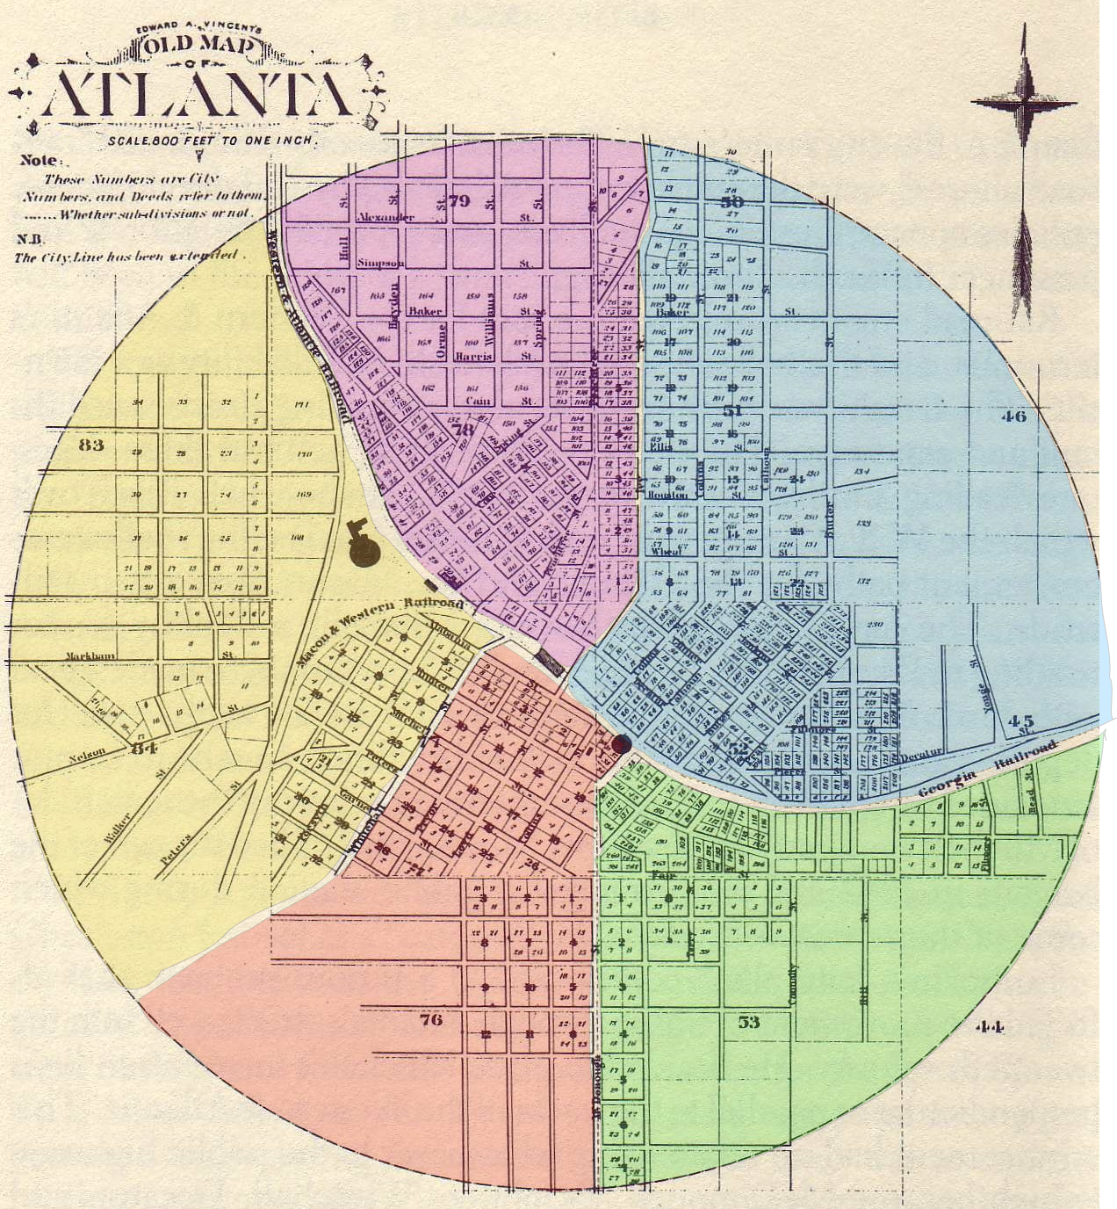
WHAT IS ARCHIVAL ADVOCACY?
Notes:
The Advocacy Committee is interested in asking a big question; that is, how can archivists demonstrate the collective impact of archival work that is understood by stakeholders outside of the profession?
We believe that archives have a demonstrable economic, social, and political value that can be articulated via quantitative and qualitative data collection. To show a wide impact, archival data collection works best when gathered collectively across a commonality like geographies, subjects, or communities.
This is a large undertaking, and the data needed for collective impact statements means we need to ask ourselves a new and different set of questions.
Image – public domain 1851 Atlanta map

Slide 5
EXAMPLE: LIBRARY ADVOCACY
“Academic librarians provide information services for almost 38 million people each year – reaching almost six million more than attend men’s college basketball games”
…and yet…
“College libraries receive fewer than 3 cents of every $1 spent on higher education.”
-- ALA Office for Library Advocacy and ALA Office for Research and Statistics. 2017
Notes:
Throughout our research we’ve been struck by sister professions and the robustness of their advocacy materials compared to the archival profession.
Museums are also adept at making the case for the place and impact of their collections on their constituents.
The goal here is to make a statement that resonates with the general public and stakeholders. We hope to come up with similar statement about Atlanta-area archives.

Slide 6
Research Design
Research Question: How can archivists demonstrate the collective impact of archival work measurements that are understood by stakeholders outside of the profession?
Thesis: Archives have a demonstrable economic, social, and political value that can be articulated via quantitative data collection. To show a wide impact, archival data collection works best when gathered collectively across a commonality: geographies, subjects, communities, etc.
Data gathering and metrics development through initial survey distributed to the Archives Council members
Notes:
This way of thinking and the data points gathered are meant to cultivate advocates not only internal but also (more importantly) external to the profession.
Instead of reporting the linear footage processed annually, record the budget spent on archival materials and staff time. Where did those supplies come from? Who is being employed?
Most archives collect the number of visitors that come into the reading room. Do you ask them where they come from? Where they stay as out of town visitors? Does the archives recommend services outside of the archives for duplication? Eating? Site-seeing?

Slide 7
Survey Design & Implementation
Collections (representing important political constituents) (Q2, Q3, Q10)
Researchers (focus on their economic impact during their visit) (Q4, Q5, Q6, Q7, Q11)
Products (creative products from our collections, documentaries, GPB broadcasts, etc.) (Q12, Q13)
Targeted Networks (institutional affiliation and institution’s friends in political/economic arena)(Q12, Q13, Q14, Q15, Q16, Q17, Q18, Q19)
Significant Collection Donors (relate collection donations to monetary donations) (Q15, Q16, Q18, Q19, Q20, Q21)
Auxiliary Businesses (dependent on our activities - archival supply companies, Crawford, other outsourced services) (Q7, Q21, Q22, Q23)
Auxiliary/Related Fields (e.g. historic preservation - need archival sources for historic preservation) (Q12, Q13, Q14)
Identify related Atlanta-metro trends linked to economic growth (like film industry) and demonstrate relationship)
Notes:
Survey Design
Our respondent pool is the 22 members of the Archives Council. Initial brainstorming sessions to develop the survey instrument generated eight categories of information around which to develop universal impact statements. The eight categories are listed on the slide with relevant survey questions indicated in brackets.
Our survey questionnaire consisted of 23 questions. Most of the question were built as multiple choice with an “other” option to give a respondent an opportunity to write in a free text box other tanswers not provided.
We used Qualtrics survey software to construct our questionnaire and create a sharable link that was distributed through the Archives Council listserv.
We set an initial response period of 1 week in October 2017. We reopened the survey for an additional 8 weeks from December 2017-February 2018.

Slide 8
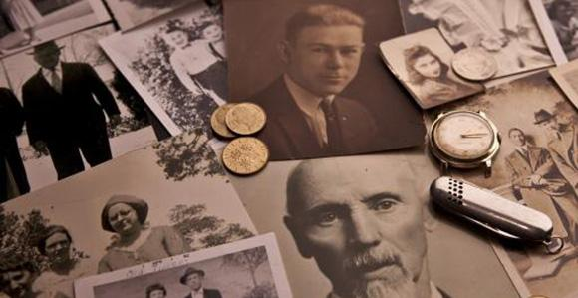
Initial Findings (Selected)
Over half (57%) reported supporting historic preservation projects; 33% support community development projects and 10% support public policy initiatives.
ARCHE archive institutions engage in 33,857 reference
transactions and 17, 804 patron visits per year
Collectively, we spend approximately $72,500 per year in the daily course of business.
Notes:
Selection of initial findings
One of the ways ARCHE archive institutions contribute to their communities is by supporting allied institutions and programs. Over half (57%) reported supporting historic preservation projects; 33% support community development projects and 10% support public policy initiatives.
ARCHE archive institutions also leave a footprint by their expenditures. Besides providing employment for staff and administrators, these institutions expend budgets on preservation
supplies, digitization and reproduction, digital hosting and physical storag), software licenses, and consulting work.
The information revealed that we had decent data on our collection strengths and usage but there was little known about where our researchers come from. We also realized that some of the responses required individual follow up to understand the intent behind answers.

Slide 9
Next Steps
Short Term:
Preliminary survey to gather metrics behavior among ARCHE members (completed)
Survey data to demonstrate archival impact
Elevator Speeches (30 second, 2 minute, 5 minute)
Relationship building outside of the archival community
Long Term:
Succinct report articulating the major impacts of ARCHE Archives Council members as a whole.
Extensible programming that works for the variety of ARCHE Archives Council Members and beyond
Notes:
Where do we go from here? Tamara and I will be following up with some members to clarify responses or to ask about blanks in the survey. We then will focus on one or two of these areas
of inquiry during our Archives Council meetings or perhaps with smaller focus groups outside of the meetings.
This is a long term project with quick win and distant outcomes.
A few of the potential product deliverables we have come up with - elevator speeches, and creating a succinct report with the major impact areas of the Archives council Members.
SAA is embarking on ways to collect, analyze, and understand archival impact at a national level. For more information come to the Public Services Assessment Committee Open Forum tomorrow 4-5:15

Slide 10
Thank You!
Tamara Livingston, tlivings@kennesaw.edu
Amanda.Pellerin@library.gatech.edu
Notes:
Thank you for your attention and any feedback you may have for us. I will be around the poster sessions to answer questions and chat about the project or feel free to send an email to myself or Tamara.

